Slide 1
Fluid Navigation
Ying shen
School of software engineering
Tongji university

Slide 2
Outline
Introduction
Navigation by selection
Small displays
Content organization
Audio menus
Form fill-in and dialog boxes

Slide 3
Outline
Introduction
Navigation by selection
Small displays
Content organization
Audio menus
Form fill-in and dialog boxes

Slide 4
Introduction
Navigation enables users to know where they are and to steer themselves to their intended destination
Navigation is about getting work done through a series of actions
Key to successfully operating interactive applications
The goal for designers is to enable fluid navigation that allows users to get to where they want to go
Navigation techniques include menus, embedded links, or tool palettes
Users can touch, tap, or swipe of the figures to indicate their choices
Careful design, keyboard shortcuts, and gestures allow expert users to navigate quickly

Slide 5
Outline
Introduction
Navigation by selection
Small displays
Content organization
Audio menus
Form fill-in and dialog boxes

Slide 6
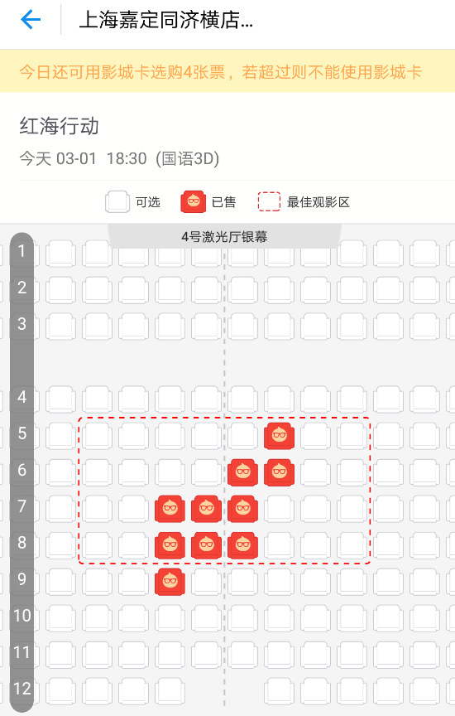
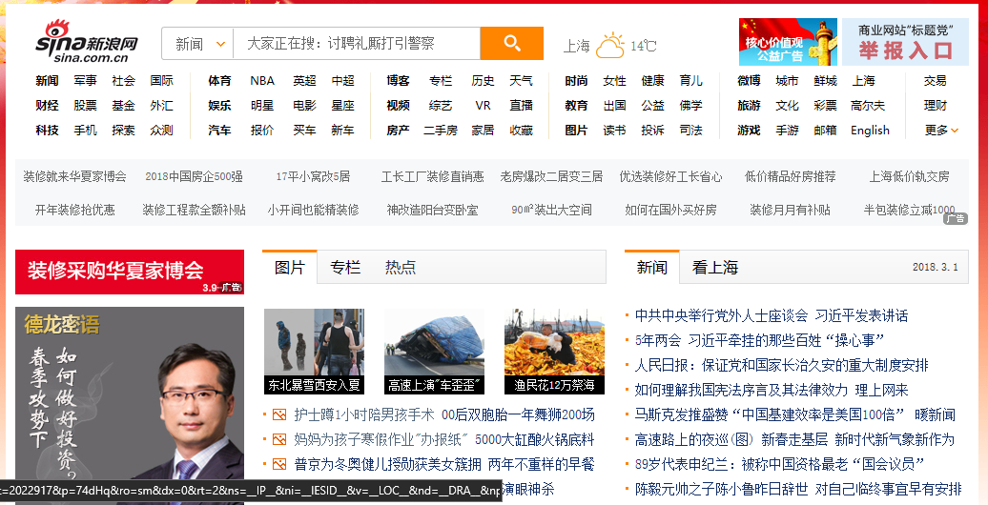
Navigation by selection
Choices can be presented explicitly
Embedded links of webpages were first popularized in the Hyperties system
Highlighted names, places became menu items embedded in text
Graphical techniques are an attractive way to present choices

Slide 7
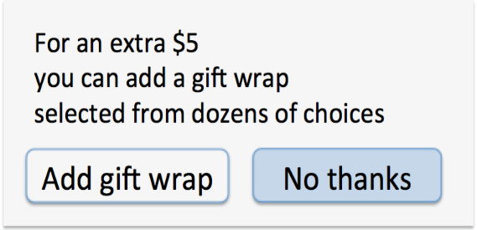
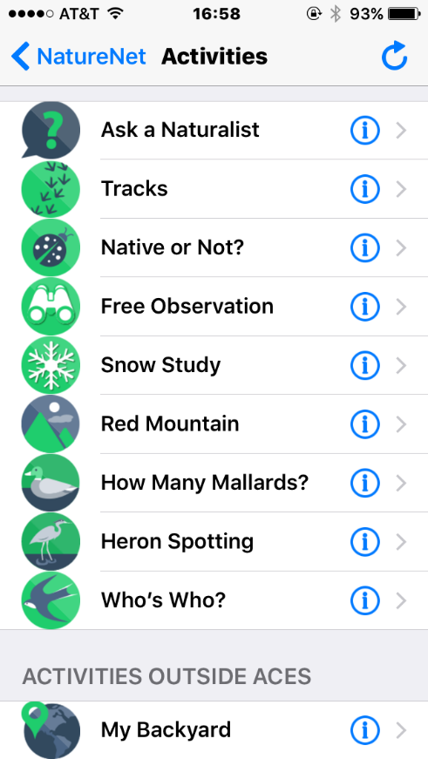
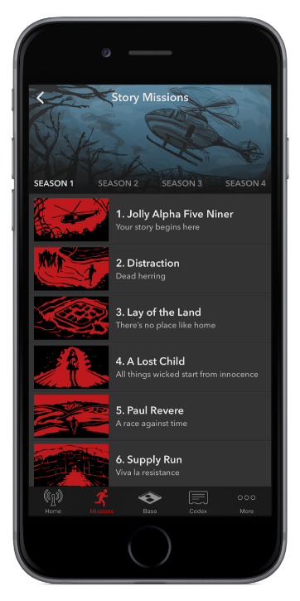
Navigation by selection
Binary menu
Grid menu

Slide 8
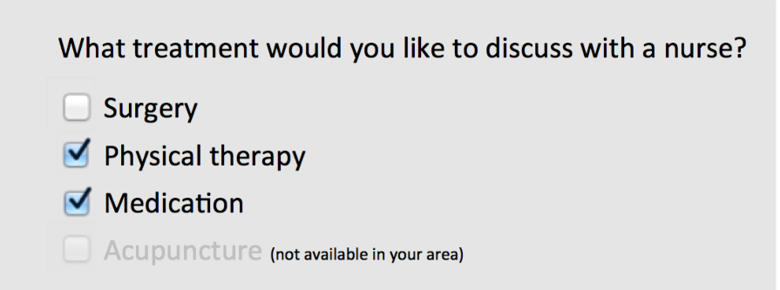
Navigation by selection
Series of choices
Radio Buttons and Checkboxes

Slide 9
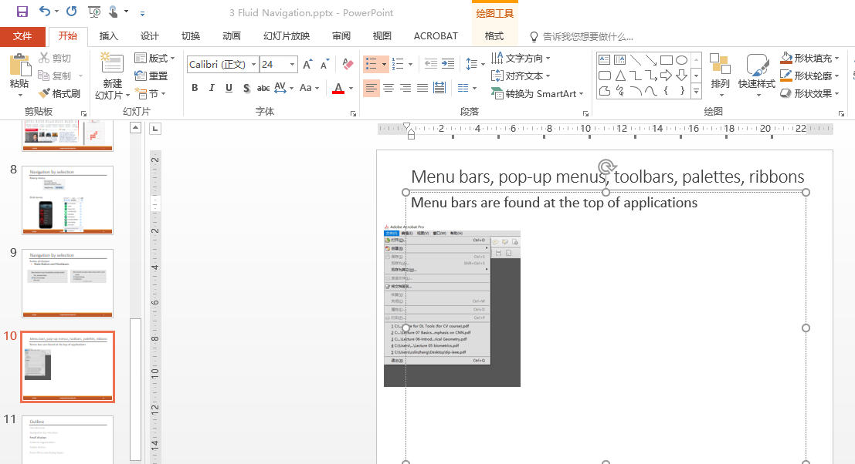
Menu bars, pop-up menus, toolbars, palettes, ribbons
Menu bars are found at the top of applications or both at the top and on the side of the screen

Slide 10
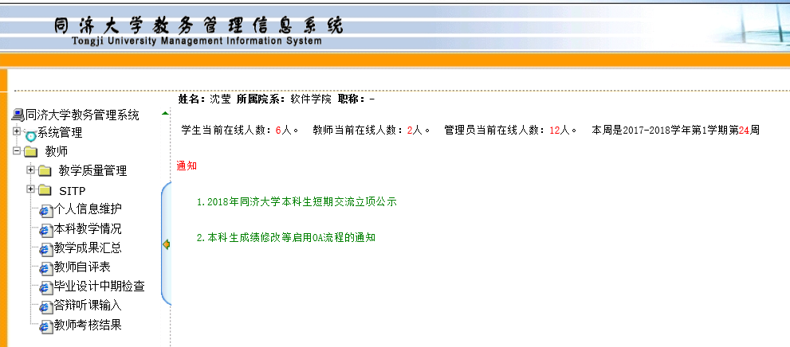
Menu bars, pop-up menus, toolbars, palettes, ribbons
Accordion menus
Advantages: Users don’t have to scroll too far to find submenu items
Disadvantages: When the menu structure is too deep, it’s not easy for users to find the target item

Slide 11
Menu bars, pop-up menus, toolbars, palettes, ribbons
Large submenus are expanded below or to the side

Slide 12
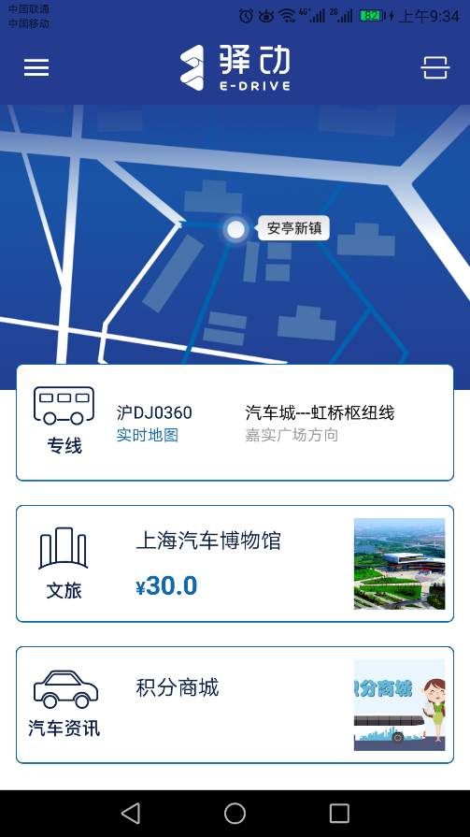
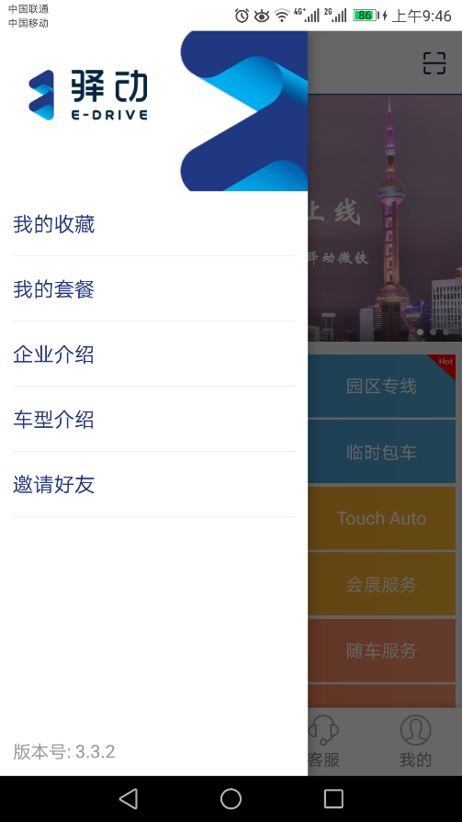
Menu bars, pop-up menus, toolbars, palettes, ribbons
The limited screen space of mobile devices leads to limited items
Menu items are moved into a separate screen that is accessible from a main menu icon (hamburger menu icon)

Slide 13
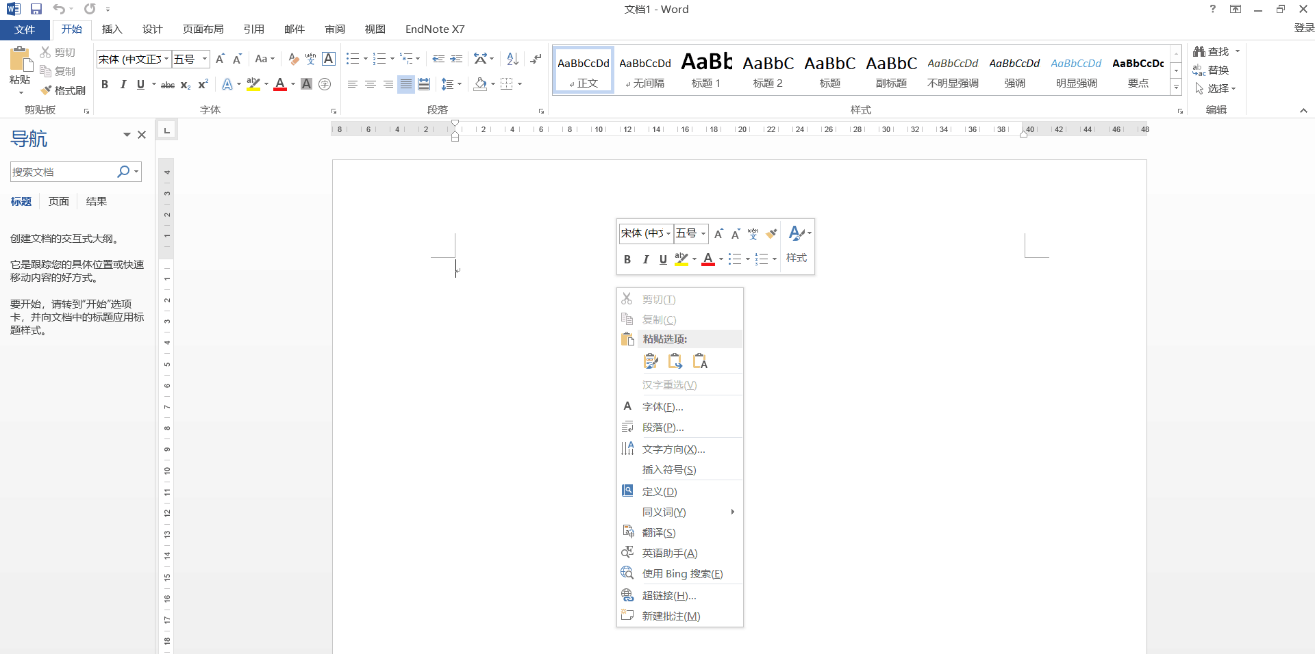
Menu bars, pop-up menus, toolbars, palettes, ribbons
Pop-up menus appear when clicking or tapping with a pointing device
When the content of the pop-up menu depends on the cursor position, it is called a context menu

Slide 14
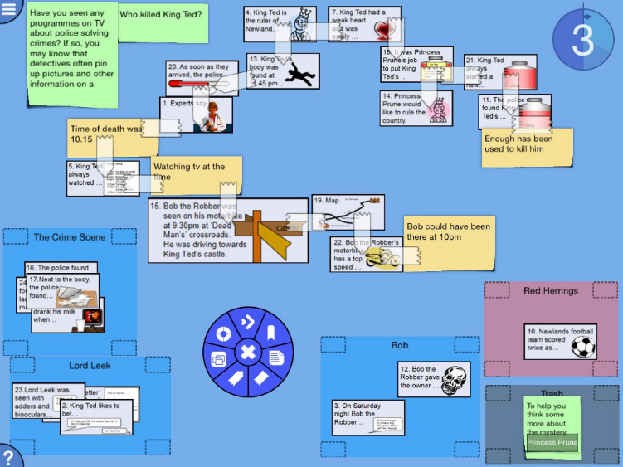
Menu bars, pop-up menus, toolbars, palettes, ribbons
Pop-up menus can also be organized in a circle to form pie menus
Advantages: The average distance to travel to select an item is smaller than linear menus

Slide 15
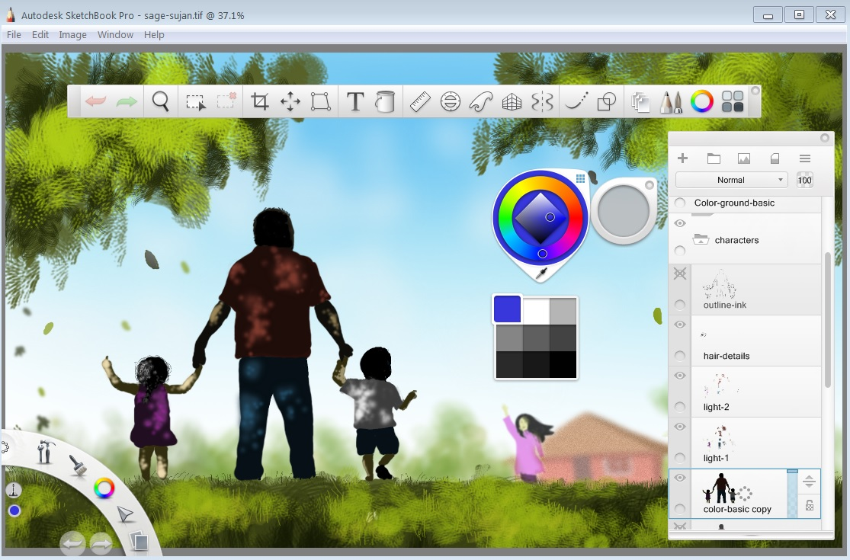
Menu bars, pop-up menus, toolbars, palettes, ribbons
Toolbars, iconic menus, and palettes can offer many actions that users can select with a click and apply to a displayed object
Users need to be able to customize toolbars
Users can eliminate most or all the toolbars and palettes to conserve screen space
Experts can have dense menus with many small icons

Slide 16
Menu bars, pop-up menus, toolbars, palettes, ribbons
Ribbons ere introduced in Office 2007
Ribbons attempt to replace menus and toolbars by one-inch tabs grouping commands by task

Slide 17
Shortcuts and gestures for rapid interaction
Keyboard shortcuts/hotkeys are essential for expert users
Ctrl-C, Ctrl-V, etc
The first letter of the command is often used for the shortcut
Shortcuts should be used consistently across applications
Learning shortcuts is one useful way to reaching expert performance

Slide 18
Shortcuts and gestures for rapid interaction
Since typing keyboard shortcuts become impractical with touchscreen devices, gestures often serve as a shortcut for rapid selection
Gestures can be hard to discover and learn and have few or no affordances
Careful design and use of gestures can bead to fluid navigation for expert users but cause frustration when actions are triggered inadvertently
Allowing users to customize the gestures may help users remember them and provide better accessibility

Slide 19
Shortcuts and gestures for rapid interaction
Examples of common gestures and their effect:
Tap: select
Long press: varied, from magnified cursor (iOS) to showing a tooltip (Windows 8)
Double tap: varied, e.g. zoom (iOS)
Small swipe: varied, e.g. move location or order of objects, reveal a delete button
Large swipe: usually scroll
Rapid swipe or fling: fast scroll with inertia
Pinch and spread: zoom in and out
Variation with two or more fingers: varied effects

Slide 20
Long lists
Sometimes the menu items may be too long to be displayed
A common solution is to create a tree-structured menu
Typical lists are alphabetically ordered, but categorical lists may be useful

Slide 21
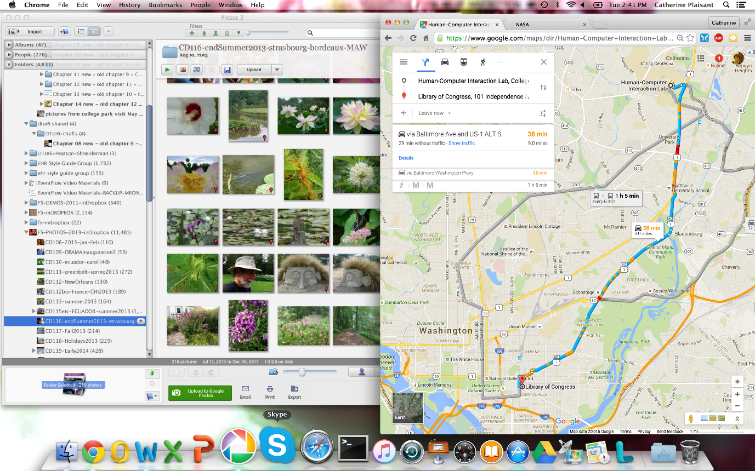
Long lists
Scrolling menus, combo boxes, and fisheye menus

Slide 22
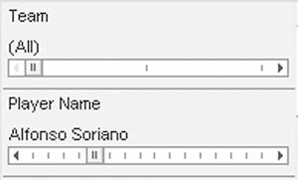
Long lists
Sliders and alphasliders
When items consist of ranges or numerical values, a slider is a natural choice to allow the selection of a value
The alpha-slider uses multiple levels of granularity in moving the slider thumb and therefore can support tens or hundreds of thousand of items

Slide 23
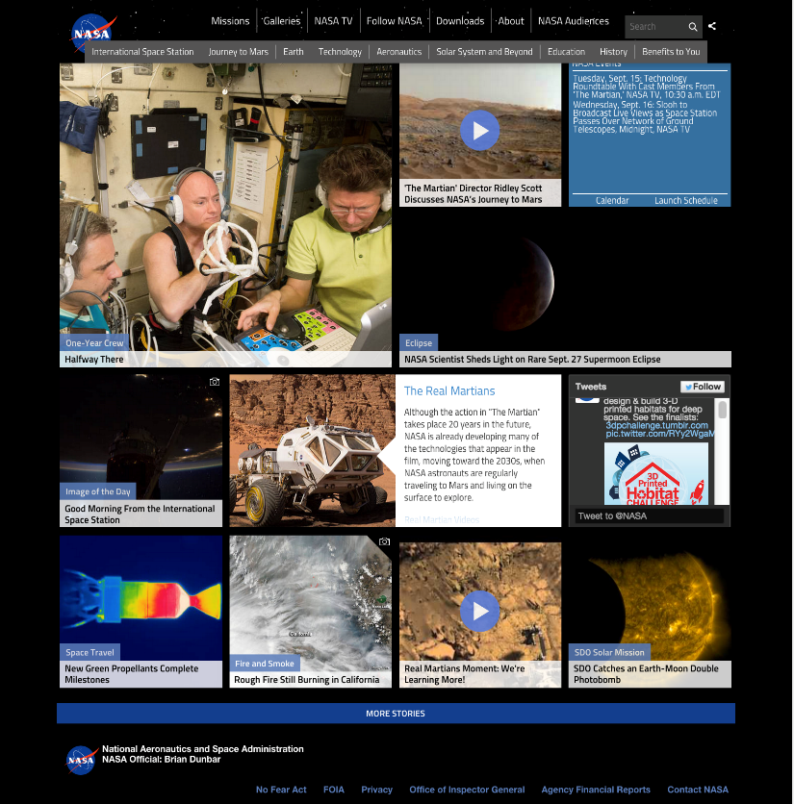
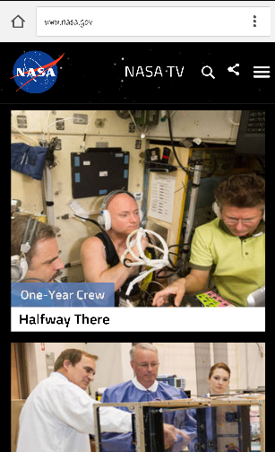
Long lists
Two-dimensional mega menus give users a good overview of the choices, reduce the number of required actions, and allow rapid selection
Notes:
The NASA website on the left consists of a large scrollable two-dimensional menu
Below the main menu each square or rectangle is a large button
Scrolling gives access to dozens of items easily updated and rearranged
This adaptive grid design scales down nicely to the small displays
Above is the same webpage displayed on an Android phone
The grid now appears as a single column of items

Slide 24
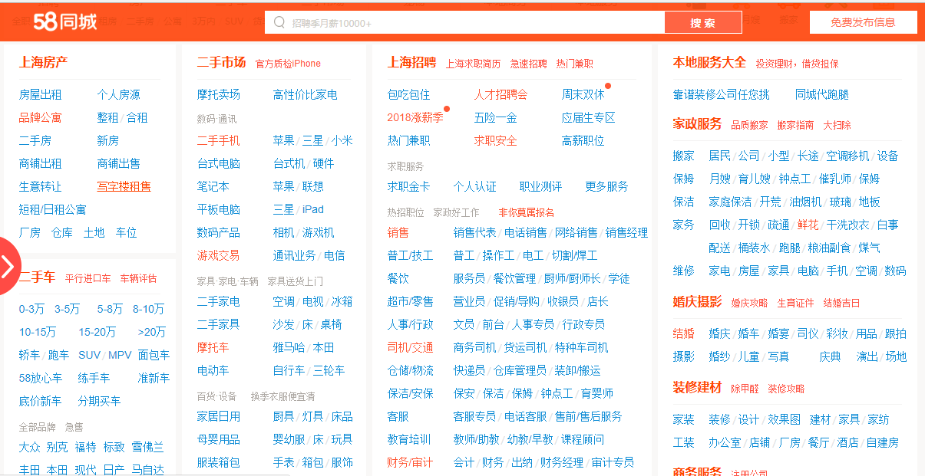
Long lists
Some designers choose the more sober style of a text-only large 2D menu
Allow users to rapidly scan hundreds of choices
Appealing for websites with little or no competition
A site map

Slide 25
Long lists
Tag clouds

Slide 26
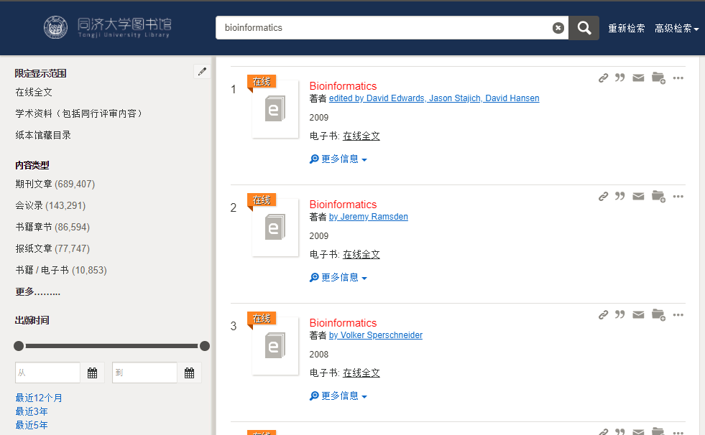
Linear versus simultaneous presentation
A sequence of interdependent menus can be used to guide users through a series of choices
Pizza-ordering interface
Installation wizards
Simultaneous menus presentment menus at the same time
Faceted search menus

Slide 27
Outline
Introduction
Navigation by selection
Small displays
Content organization
Audio menus
Form fill-in and dialog boxes

Slide 28
Small displays
Small devices have very focused functionalities and few selectable areas.
The smaller the screen, the more temporal the interface becomes
Linear sequences of menus
Discoverability is often an issue

Slide 29
Small displays
Design considerations for small displays:
Simplify: “less is more”
Strive to reduce or eliminate data entry
Learnability is key
Consider use frequency and importance
Plan for interruptions
Use of contextual information
Make clear what is selectable and what is not
Leave room for scroll and swipe gestures to avoid inadvertent actions
Consider relegating less important functions to other platforms

Slide 30
Outline
Introduction
Navigation by selection
Small displays
Content organization
Audio menus
Form fill-in and dialog boxes

Slide 31
Content organization
Organizing menus in a meaningful structure results in faster selection time and higher user satisfaction
Menu items should be organized by categories and have understandable meanings
Comprehensible and distinctive
Approaches:
Linear sequence (e.g. in a wizard or survey)
Hierarchical structure that is natural and comprehensible (e.g. a store split into departments)
Network structure when choices may be reachable by more than one path (e.g. websites)
Notes:
Content organization is similar to restaurant menus, which separate appetizers, main dishes, desserts, and beverages to help customers organize their selections.

Slide 32
Structure and breath versus depth
Categorize similar items using tree structures
Tree-structured menus are suitable to novice or intermittent users
Rules for forming menu trees:
Use task semantics to organize menus
Limit the number of levels (i.e. prefer broad–shallow to narrow–deep)
Create groups of logically similar items: e.g. Level 1: countries, Level 2: states, Level 3: cities
Form groups that cover all possibilities: e.g. Age ranges: [0–9] [10–19] [20–29] and [>= 30]
Make sure that items are non-overlapping: e.g. use “Concerts” and “Sports.” over “Entertainment” and “Events”
Arrange items in each branch by natural sequence (not alphabetically) or group related items
Keep ordering of items fixed (or possibly duplicate frequent items in dedicated section of the menu)

Slide 33
Structure and breath versus depth
If the groupings are natural and comprehensible, users can easily accomplish the tasks
Use the terminology from the task domain instead of using a vague title
“Main Menu Options” vs “Friendlibank Service”

Slide 34
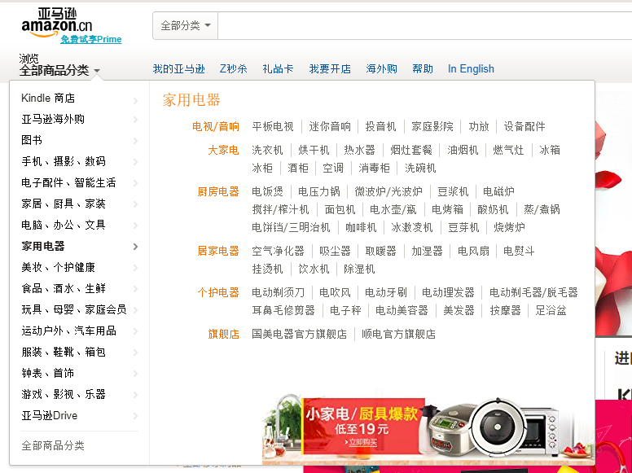
Structure and breath versus depth
Breadth vs depth
The breath is preferred over depth
Given sufficient screen space, it’s better to show a large portion of the menu structure
Notes:
More items are put into the main menu. No more than three to four levels.

Slide 35
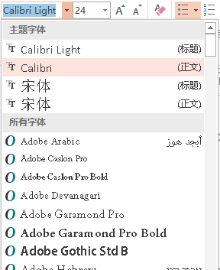
Sequence, phrasing, and layout
Sequence
Designer is confronted with the choice of presentation sequence
Some items have a natural sequence and some do not
Categorical organization is preferred
Split menus extract three or four of the most frequently used items and put them near the top while preserving the order of the remaining items
Adaptive menus provide users with control over the sequence of menu items
Notes:
Additional considerations for content organization design include sequence, phrasing, and layout
Alphabetic order, grouping of related items, and most frequently used items first.

Slide 36
Sequence, phrasing, and layout
Phrasing
For single menus, a simple descriptive title that identifies the situation is necessary
Some directives
Use familiar and consistent terminology.
Ensure that items are distinct from one another
Use consistent and concise phrasing
Bring the keyword to the fore

Slide 37
Sequence, phrasing, and layout
Layout
Techniques to indicate position in the menu structure can be useful
Elements included: Titles, item placement; instructions, error messages
As the user goes down the tree structure, the titles can be designed to indicate the level or distance from the main menu
Graphics, fonts, typefaces, or highlighting techniques can be used beneficially
Notes:
The set of headers below from the Library of Congress collections webpages gives a clear indication of progress down the tree
When users want to do a traversal back up the tree or to an adjoining menu at the same level, they will feel confident about what action to take

Slide 38
Outline
Introduction
Navigation by selection
Small displays
Content organization
Audio menus
Form fill-in and dialog boxes

Slide 39
Audio menus
Audio menus are useful in interactive voice response(IVR) systems
With audio menus, instruction prompts and options are spoken to users
Audio menus have to provide a confirmation step following the selection
To reduce dependence on short-term memory, it is preferable to describe the item first and then give the number
A way to repeat the list of options and an exit mechanism must be provided

Slide 40
Audio menus
Complex and deep menu structures should be avoided
The number of choices should be less than three or four
To develop successful audio menus, it is critical to know the users’ goals, make the most common tasks easy to perform rapidly, and keep prompts to a minimum
‘Listen carefully, as our menu options have recently changed’
More in Chapter 9

Slide 41
Outline
Introduction
Navigation by selection
Small displays
Content organization
Audio menus
Form fill-in and dialog boxes
Notes:
Selection is effective for choosing an item from a set of choices, but if the entry of names or numeric values is required, typing becomes more attractive.
When many fields of data are necessary, the appropriate interaction style is form fill-in.
The combination of form fill-ins, menus, and custom widgets such as calendars or maps supports rapid navigation for a vast array of applications.

Slide 42
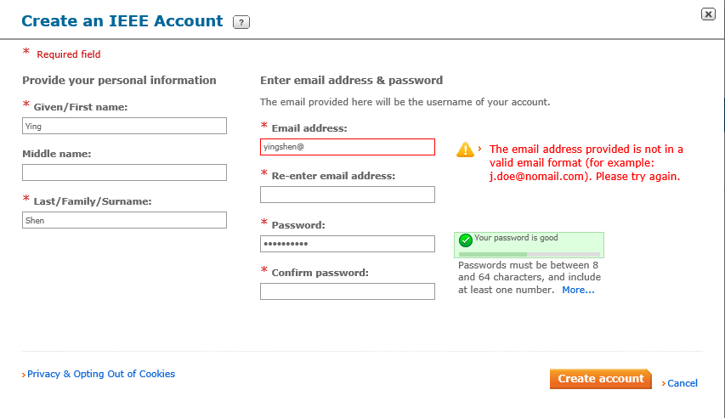
Form fill-in
This form fill-in allows users to enter information when joining the IEEE Society
Fields are grouped meaningfully, and field-specific rules such as password requirements are provided next to the fields
The data is validated as soon as it is being provided and error messages explain how to correct the problem

Slide 43
Form fill-in
Form fill-in design elements
Meaningful title
Comprehensible instructions
Label the field
Limit data entry
Explanatory messages for fields
Error prevention
Error recovery
Immediate feedback
Logical grouping and sequencing of fields
Visually appealing layout of the form
...

Slide 44
Format-specific fields
Some common fields
Telephone numbers
Dates
Times
Dollar amounts
Passwords
CAPTCHAs (Completely Automated Public Turing test to tell Computers and Humans Apart)
Date: _ _/_ _/_ _ _ _ (04/06/2018 indicates April 6, 2018)
Deposit amount: $_ _ _ _ _._ _

Slide 45
Dialog boxes
Dialog boxes are used to request users to select options, perform limited data entry, or review alerts and error messages
Dialog boxes are often shaped and sized to fit each situation, but distinctive sizes or aspect ratios may be used to signal errors, confirmations, or components of the application

Slide 46
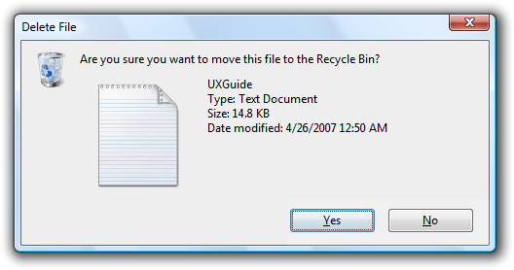
Dialog boxes
This dialog box includes a binary menu with two choices (Yes or No)
The blue highlighting on Yes indicates that this selection is the default and that pressing Return will select it
Specific keyboard shortcuts can be made available
Escape closes the dialog box
Typing the letter ‘N’ will select ‘No’ as indicated by the underlined letter ‘N’

Slide 47
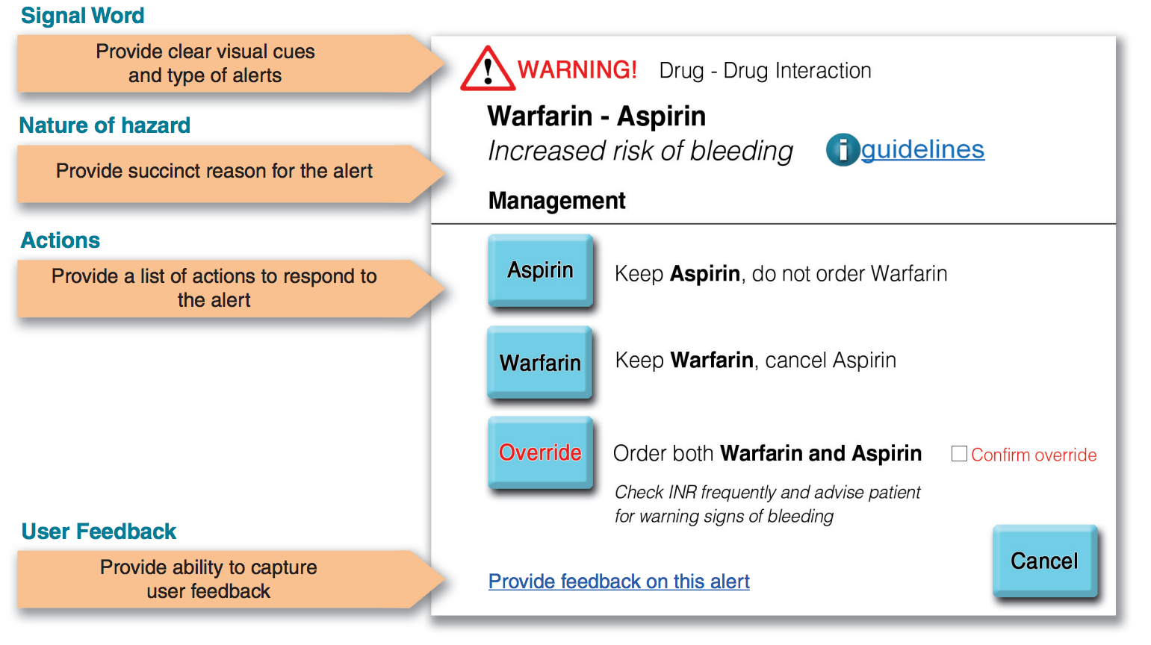
Dialog boxes
This dialog box is used to alert clinicians who try to prescribe the drug Warfarin, because it increases the risk of bleeding of patients already on Aspirin
Several possible actions are proposed
Overriding the alert is possible but requires confirmation by clicking a check box
Because of the severity of the alert, this is a modal dialog box and it requires immediate action

